Slide 1


http://www.faa.gov/regulations_policies/handbooks_manuals/aircraft/airplane_handbook/
www.airtreknorth.com Go to Seminars button password is seminar

Slide 2
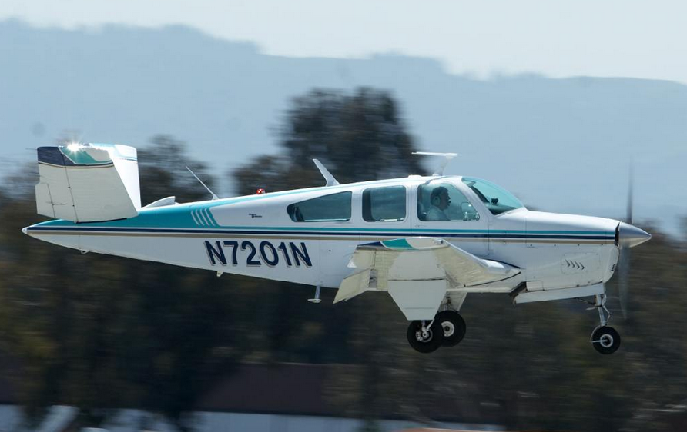
Agenda
Constant Speed Props
MP vs RPM
Comparison to Arrow II POH
Landing Gear
Safety Switches
Emergency Gear Extension
Comparison to Arrow II POH

Slide 3

Complex Airplane
Land Plane
  Wing flaps
  Controllable-pitch prop
  Retractable landing gear
Sea Plane
  Wing Flaps
  Controllable-pitch prop

Slide 4
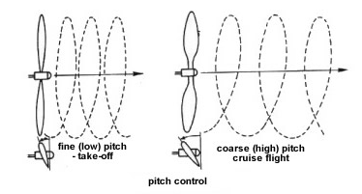
Controllable-Pitch Propeller
Fixed Pitch Prop
  Designed for best propeller efficiency at one speed of rotation (RPM) and forward speed
  Efficiency suffers outside of the optimum RPM and airspeed
  Typically designed for climb (low pitch) or cruise (higher pitch) performance
Controllable Pitch Prop
  Provides high propeller efficiency through a wide range of operation
  Efficiency over a wide range is possible because the blade angle is adjustable

Slide 5

Climb vs Descent
Constant Speed Prop
Climb
  Airplane is nosed up for a climb
  Engine will tend or want to slow down
  Prop will decrease the blade angle slightly to keep RPM from slowing down
Descent
  Airplane is nosed down for a descent
  Engine will tend or want to speed up
  Prop will increase the blade angle slightly to keep the RPM from speeding up

Slide 6
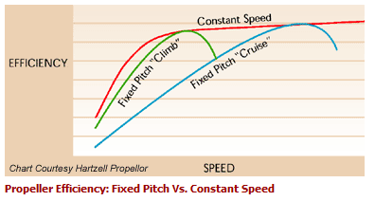
Take Off: Constant Speed Prop
At Take Off when Forward Motion is Low, we want
  High RPM (or low propellor blade angle)
  Low blade angle (or pitch) keeps the angle of attack with respect to the relative wind, small and efficient at low airspeeds
  Called ‘Slice it Thin’
  As the airspeed increases, the load is lightened on the engine
  The engine wants to speed up, but the prop adjusts to a higher blade angle automatically

Slide 7
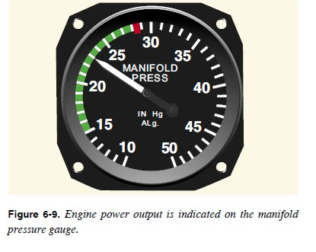
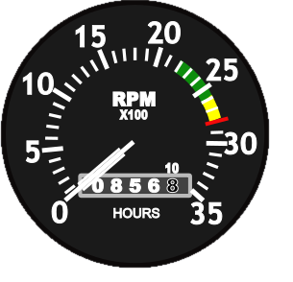
Cruise: Constant Speed Prop
Engine power is reduced by lowering the manifold pressure (MP) and increasing the blade angle (decrease RPM)

Slide 8
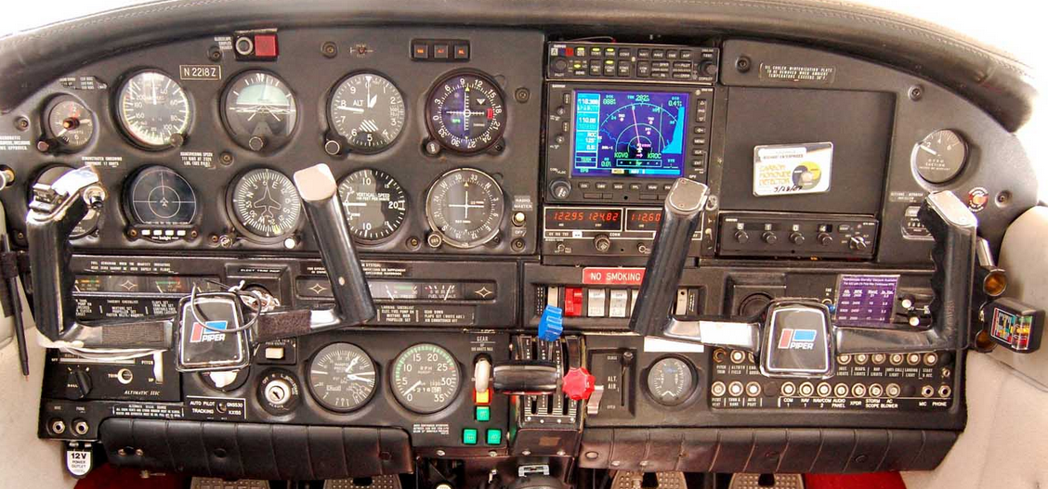
Piper Arrow Panel

Slide 9
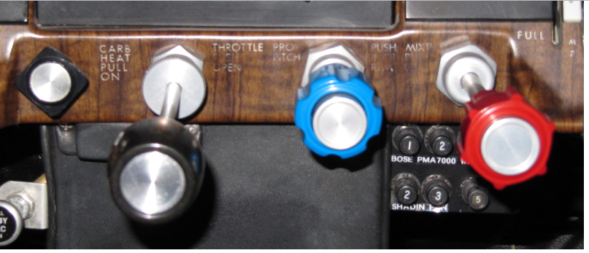
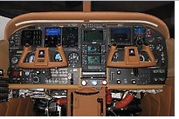
Cessna Panel

Slide 10
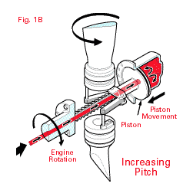
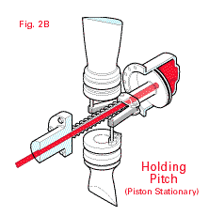
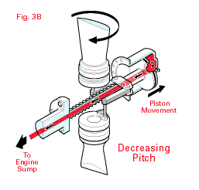
How It Works
In a single-acting propeller system, oil pressure supplied by the governor, acting on the piston produces a force that is opposed by the natural centrifugal twisting moment of the blades in constant speed models or counterweights and large springs in full-feathering systems.

Slide 11
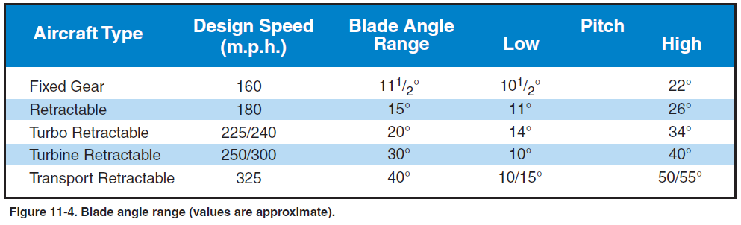
Governing Range
Propeller Pitch is Controlled by a Governor through oil pressure
Pitch varies from about 11 degs to 40 degs

Slide 12
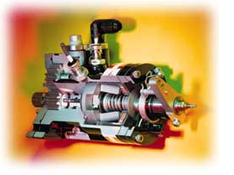
More Constant Speed Props
http://www.mccauley.textron.com/prop/prop-tech/pg00intro.html

Slide 13
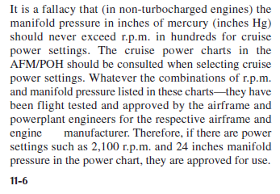
Excessive Manifold Pressure (MP)
High MP results in high stresses within the engine and high temps
High MP and low rpm can induce damaging detonation in the cylinders
Sequence when making power changes to avoid the above
  Increasing power: Increase RPM (prop control), then MP (throttle)
  Decreasing power: Decrease MP (throttle) then decrease RPM (prop control)
  Also called ‘Prop on Top’
Follow the POH for power settings
  If it calls for 24” MP and 2100RPM, they are approved
  It is a fallacy in non-turbo engines that MP should never be higher than RPM

Slide 14
Points to Remember
Tach Red Line indicates
  Maximum allowable RPM
  The RPM required to obtain rated horsepower
Momentary propeller overspeed may occur when the throttle is advanced rapidly for takeoff
  Usually not serious if redline isn’t exceeded by 10% for 3 seconds
  Apply all power changes slowly to prevent prop overspeeding
On takeoffs from low elevation airports, MP may exceed RPM. Consult POH for any limitations

Slide 15

Arrow Comparison
Propeller
  Hartzell 3 Blade
  Constant Speed Controllable Pitch
  Prop control located between throttle and mixture (blue control)
Run-up Checklist
  With prop in high RPM position, increase throttle to 2100rpm
  Slowly cycle prop control through it’s full range three times to ensure that warm engine oil has circulated through the system
    First cycle verify RPM decreases and then increases
    Second cycle, verify MP increases, then decreases
    Third cycle, verify movement on the oil pressure gauge (maybe slight)
Landing and approach
  Prop control should be set for 2600rpm to ensure ample power for emergency go-around and will prevent over-speeding of the engine if the throttle is advanced sharply

Slide 16
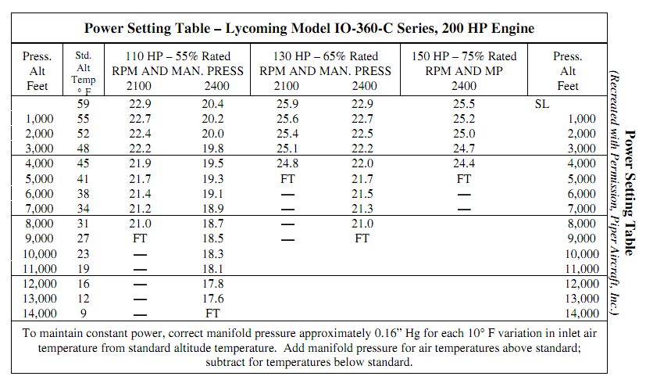
Arrow II: MP vs RPM for Cruise

Slide 17
Retractable Landing Gear
Landing Gear Systems
  Electrical
    Uses an electrically driven jack
  Hydraulic
    Uses pressurized fluid
  Electro-hydraulic
    Electric pump is used to pressurize the hydraulic fluid

Slide 18
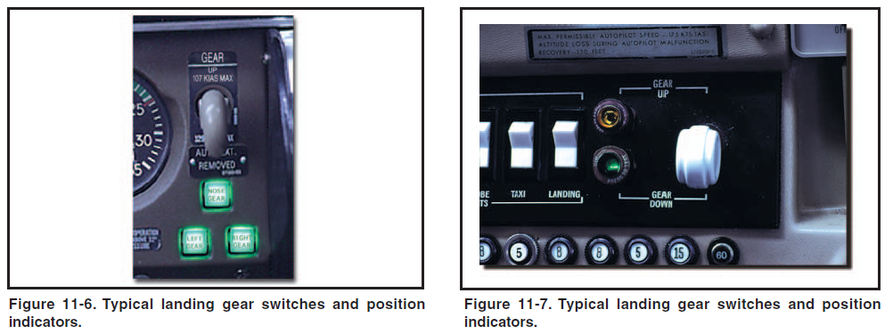
Controls and Position Indicators
Landing Gear is Controlled by a Switch in the Cockpit
Two Types of Landing Gear Indicators are Shown Below
  The Indicators (lights) usually are ‘Press to Test’ and Interchangable

Slide 19
Landing Gear Safety Devices
Gear Warning Horn
  Normally linked to throttle or flap position and/or airspeed indicator
  Below a certain airspeed, configuration or power setting with the gear up, the warning horn will sound
Mechanical Down-locks
  Safety Switch or Squat Switch
    Usually mounted in a bracket on one of the main gear shock struts.
    When strut has the weight of the airplane, the switch opens the electrical circuit to the motor or mechanism that powers retraction
    If landing gear switch is placed in RETRACT position, horn will sound
  Ground Locks
    Pin installed in aligned holes
    Spring loaded clips
    All have red streamers attached so you don’t take off with them in

Slide 20
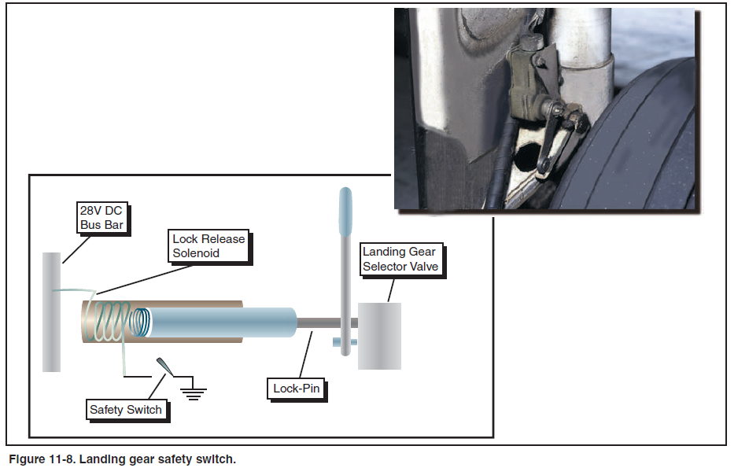
Squat Switch

Slide 21
Emergency Gear Extension Systems
Emergency extension system lowers the landing gear if the main power system fails
Emergency release handles
  Releases the uplocks and allows the gears to free fall, or extend under their own weight
  Or release of the uplock is accomplished using compressed gas, directed to uplock release cylinders
Forceful Gear extensions
  Hydraulic pressure may be provided by a hand pump, an accumulator or and electrically powered hydraulic pump

Slide 22
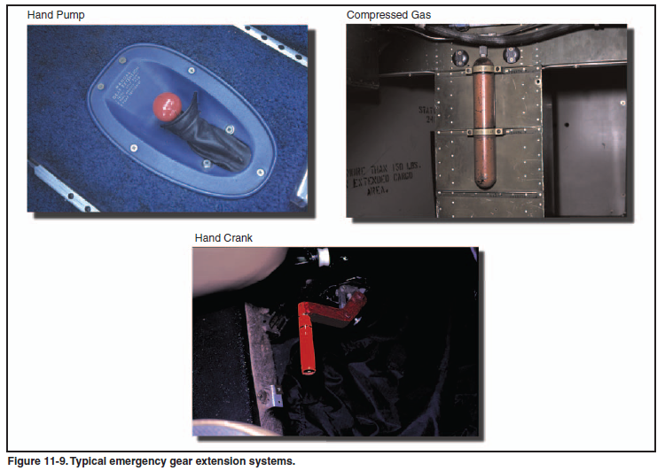
Emergency Gear Extension Systems

Slide 23
Preflight Procedures
Inside the cockpit
  Landing gear selector switch is in the GEAR DOWN
  Turn on the battery master and ensure landing gear position indicators show the gear down and locked
External
  Landing gear
  Wheel well
  Adjacent areas free of mud, snow, ice, debris
  Dirty switches and valves may cause false indications or interrupt extension cycles so gear isn’t locked down
  Gear doors aren’t bent
  Shock struts properly inflated and pistons clean
  Gear uplock and downlock mechanisms should be checked for general condition
  Power sources and retracting mechanisms should be checked for general condition
  Hydraulic lines should be check for signs of chafing and leakage
  Micro switches checked for cleanliness
  Actuating cylinders, sprockets, universals, drive gears, linkages and any other accessible components check for condition
  All bolts and rivets intact and secure
  No distortion, cracks in any of the airplane structure around the gear or gear doors

Slide 24
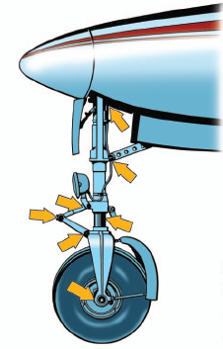
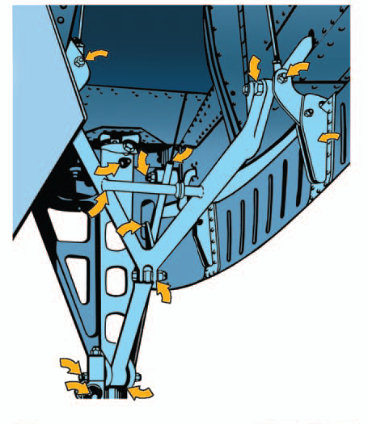
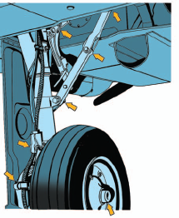
Preflight External

Slide 25
Takeoff and Climb
Retract the landing gear after lift-off when the airplane has reached an altitude where the airplane can no longer land on the runway if takeoff is aborted
As the gear retracts, airspeed will increase and pitch attitude may change
Retraction may take several seconds, know your airplane
Gear retraction and locking is accompanied by sound and feel that is unique to each make and model
Abnormal landing gear retraction is most often a clear sign that the gear extension cycle will also be abnormal

Slide 26
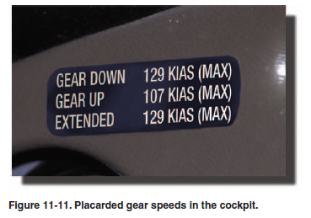
Approach and Landing
V_{LE}
  Max speed for extended gear
V_{LO}
  Max speed gear can be
  operated
  Gear in transition up and down
Extend the gear abeam your landing point on a normal traffic pattern
Verify gear is down on downwind, base, final and then again just before reaching the runway
Landing roll should be completed and the airplane clear of the runway before any levers or switches are operated
  Landing gear strut safety switches will be actuated, deactivating the landing gear retract system
  After clearing the runway, pilot can focus on the after landing checklist

Slide 27
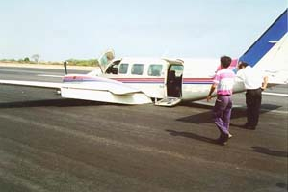
Most Common Factors Gear Accidents
Neglected to extend landing gear
Inadvertently retracted landing gear
Activated gear, but failed to check gear position
Misused emergency gear system
Retracted gear prematurely on takeoff
Extended gear too late

Slide 28
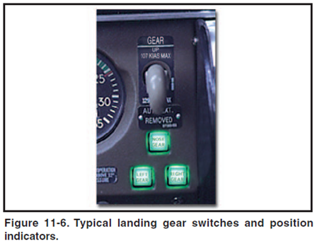
Arrow II Landing Gear
Retractable Tricycle Gear
Hydraulically actuated by an electrical reversible pump
Pump controlled by a selector switch
Landing gear takes about 7 seconds to retract or extend
Has an automatic extension of the gear at low airspeed/low power conditions
  Holding the emergency lever in the up position overrides the auto extension feature
A pitot tube like sensor (located above pilot side wing) senses the airspeed and prop slip stream
The emergency gear lever manually releases hydraulic pressure to permit the gear to free-fall with spring assistance on the nose gear
  Emergency lever is held in the down position
Three green lights indicate gear are down and locked. Lights out indicate gear is up

Slide 29
Arrow II Landing Gear
Warning horn and red ‘Warning Gear Up’ light activates under the following conditions
  Gear up & power below 15” MP
  Gear extended by back-up gear extender system but gear selector ‘UP’ (except at full throttle)
  Gear selector is ‘UP’ when on the ground

Slide 30
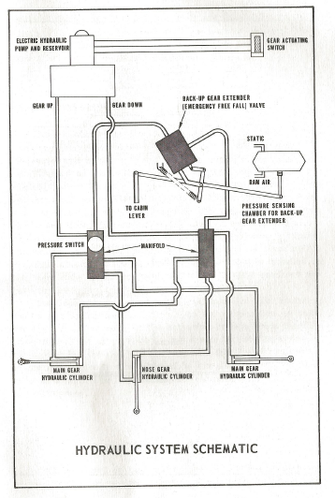

Slide 31
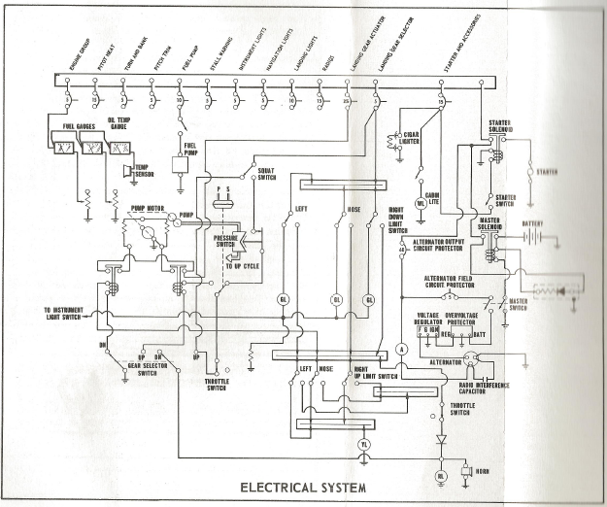

Slide 32
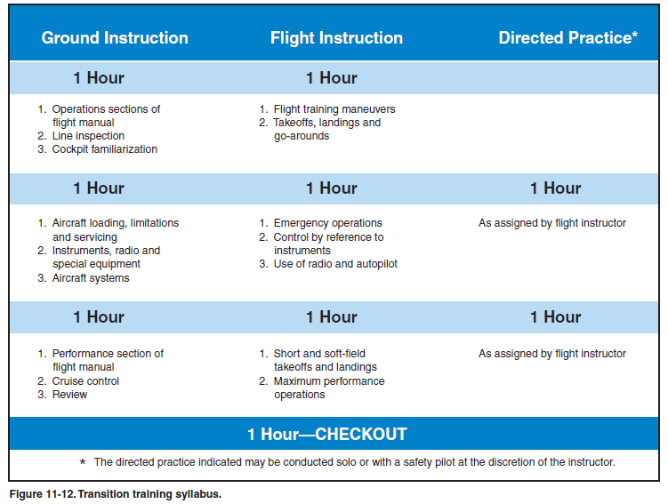
Sample Complex Training Syllabus

Slide 33
Agenda
Constant Speed Props
MP vs RPM
Comparison to Arrow II POH
Landing Gear
Safety Switches
Emergency Gear Extension
Comparison to Arrow II POH

