Slide 1
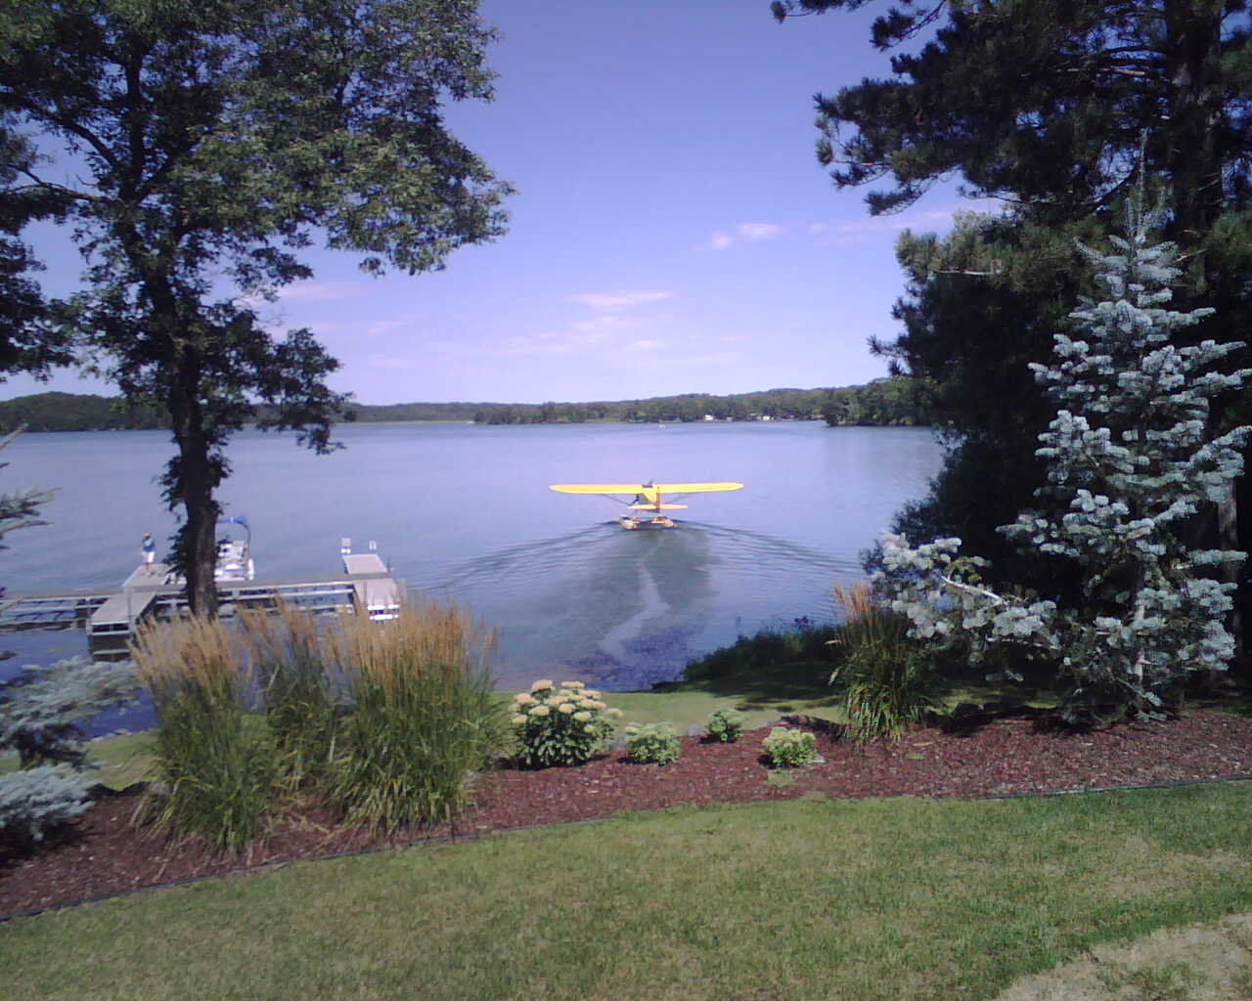
Seaplane Transition
Ground Training
www.airtreknorth.com

Slide 2
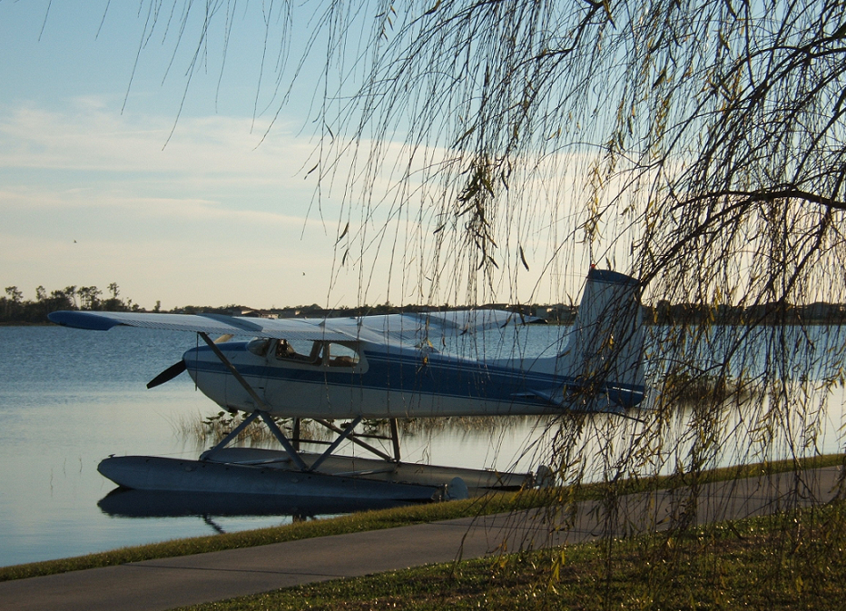
Seaplane Add-On Rating Rqts
(Assumes at least Private Pilot)
No minimum times except
  3 hrs of flight instruction within last 60 days.
Two endorsements
  Add’l aircraft class rating CFR 61.63 (c)
  Completion of Prereq’s for Practical Test CFR 61.39 (a)(6)
Pass Practical Test by DPE (Designated Pilot Examiner).
  No written test is needed.
  19 PTS tasks for seaplane add-on rating.
What does the above mean?
  Approximately 6-10 hrs of flying time.
  ~$400 DPE fee.
  Normally, rating is <$2000 depending on experience skill level of applicant.

Slide 3
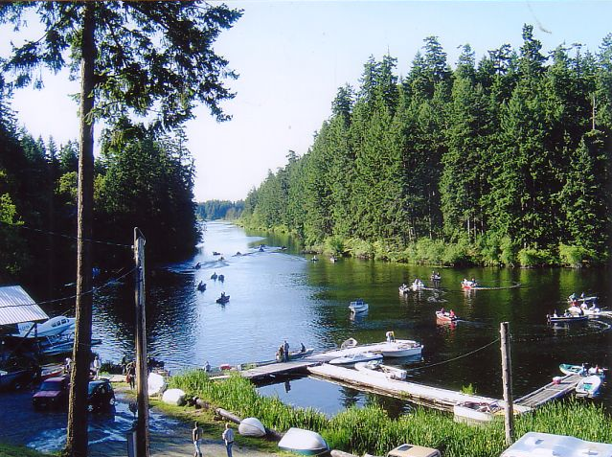
Right of Way CFR 91.115
General. Each person operating an aircraft on the water shall, insofar as possible, keep clear of all vessels and avoid impeding their navigation, and shall give way to any vessel or other aircraft that is given the right-of-way by any rule of this section.
Crossing. When aircraft, or an aircraft and a vessel, are on crossing courses, the aircraft or vessel to the other’s right has the right-of-way.
Approaching head-on. When aircraft, or an aircraft and a vessel, are approaching head-on, or nearly so, each shall alter its course to the right to keep well clear.
Overtaking. Each aircraft or vessel that is being overtaken has the right-of-way, and the one overtaking shall alter course to keep well clear.
Special circumstances. When aircraft, or an aircraft and a vessel, approach so as to involve risk of collision, each aircraft or vessel shall proceed with careful regard to existing circumstances, including the limitations of the respective craft.

Slide 4
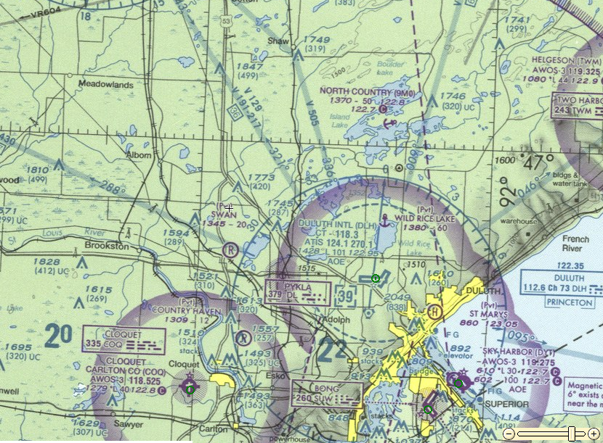
Seaplane Base Markings

Slide 5
‘Red Right Return’
(from Sea to Home)

Slide 6
Float Design
The Step is just aft of CG. The Step provides a means of reducing water drag during takeoff and high speed taxi
Multiple Bulkheads (min of 4) used to prevent floats from filling with water if ruptured. Designed to float with two bulkheads filled with water.
Each float must carry 90% of the weight of the airplane. So two floats support 180%.

Slide 7
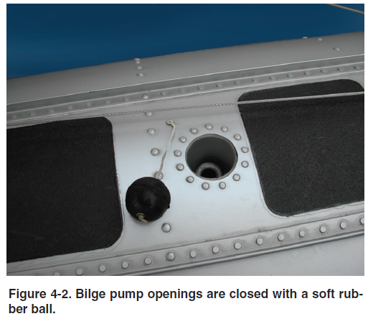
Preflight Float Water Removal

Slide 8
Water Rudders on Floats
Water rudders increase directional authority to help prevent the aircraft from weathervaning into the wind.
When Idle taxiing, water rudders will be in the down position.
If left down during high speed ops such as step taxi, takeoff or landing, the water rudders can be damaged.
Steel cables that raise and lower the water rudders must be inspected along with their pulleys and guides to assure free movement.

Slide 9
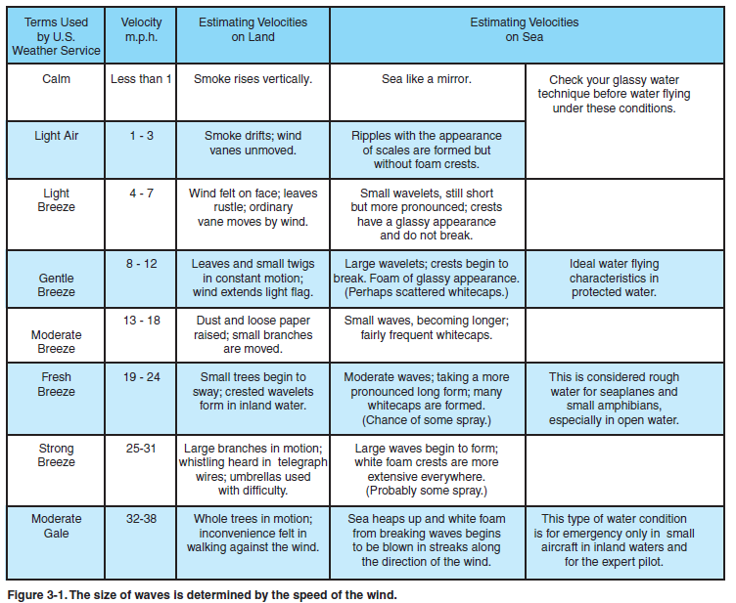
Waves vs Wind

Slide 10
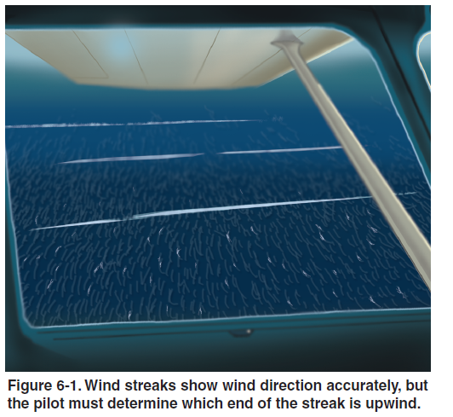
Windstreaks on Water
Windstreaks show wind direction and run parallel to the wind.
Must determine which end of the streak is upwind.
Wind streaks begin at approximately 6-8 Kts

Slide 11
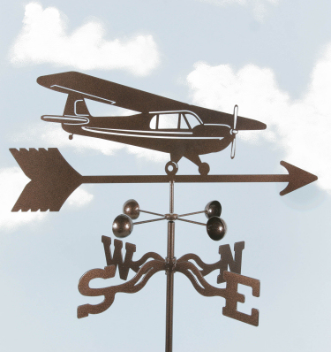
Weathervane Effect
Seaplanes will naturally weathervane into the wind, even in a slight breeze.
Weathervaning is an advantage when:
  Attempting to establish correct wind direction for takeoff.
  Attempting to turn upwind at idle power.
Weathervane effect is a disadvantage when:
  Attempting to taxi downwind or crosswind.
  Attempting to turn from upwind to downwind.
  Beaching or docking in a crosswind.

Slide 12
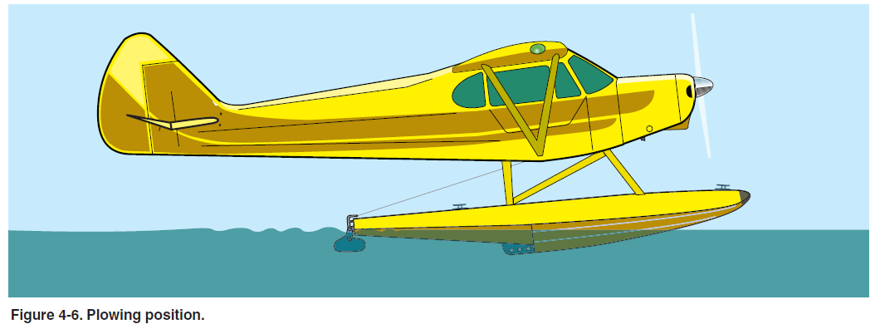
3 Taxi Options
Idle Taxi
  CARS
    Carb, Area Clear, Rudders, Stick Back
  Used for most Taxi.
  Keep 4-6 kts (<1000RPM)
  Cross Boat Wakes at 45deg
  Rudders down
Plow Taxi
  CARS (rudders down)
  High Drag
  Requires High Power
  Heat Build Up Possible
  Not Recommended
  Do not use in Wavy or Gusty Conditions due to Instability.
Elevator full up

Slide 13
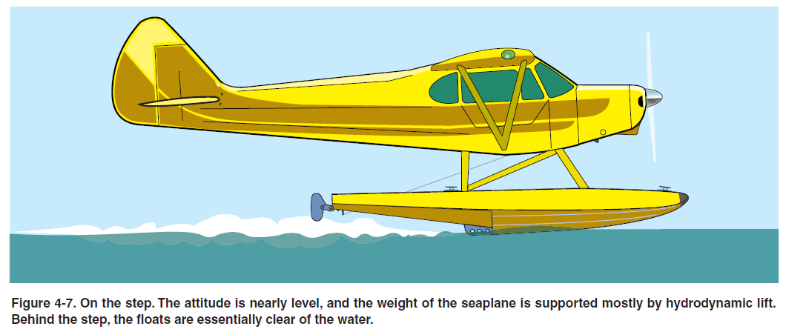
3 Taxi Options continued
Step Taxi
  CARS (Rudders up)
  Weight supported by Hydrodynamic Lift (floats)
  Weight also supported by Aerodynamic Lift (wings)
  Low Drag compared to Plow Taxi
  One Pitch Attitude provides least drag (Sweet Spot)
  60-70% of takeoff power is a good starting point once on step.
  Used to cover long taxi distances.
  Requires sufficient water depth and no obstructions
  Apply back yoke (stick back) pressure as power is reduced to idle when slowing.
  Ailerons into the wind.

Slide 14
Porpoising While on Step
Caused by Incorrect Planing Attitude (ie: not on the sweet spot).
Nose too Low.
  Forms crest of water in front of floats.
  Floats ride up over the crests.
  Floats then dip down once over the crest and the process begins again with increasing amplitude.
Nose held too High.
  Premature Lift off.
  Subsequent Stall and Nose Down drop into Water.
Corrective Action
  Reduce power
  Apply back yoke (stick) pressure.

Slide 15
Step Turns

Slide 16
Turns continued
Plane will Weathervane into the Wind.
At idle taxi with short bursts of Power
  With continuous power, seaplane accelerates, increasing the turn radius.
  The churning of the water during higher speeds makes the water rudders less effective

Slide 17
Upwind to Downwind Scenario
Most Difficult if winds are strong.
Use the Plow Taxi as it moves the CB aft. This shortens the lever arm between the center of bouyancy (CB) and the tail.
Always turn to the left to take advantage of Torque effects.
Ailerons are positioned into the wind to prevent the wind from lifting a wing.

Slide 18
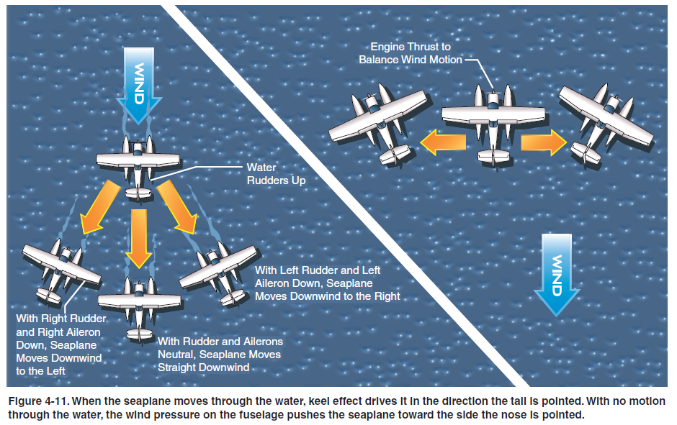
Sailing – The 4th Taxi Option
Used during Significant Winds.
Wind is used for Power (Motive Force).
Low Engine RPM with Carb Heat ON and One Mag can be used to slow down Sail.

Slide 19
Takeoff: 4 Distinct Phases
Displacement Phase
Hump or Plowing Phase
  Most Resistance
  Highest Water Drag
Step or Planing Phase
  Drag increases as the square of speed.
Lift-off Phase

Slide 20
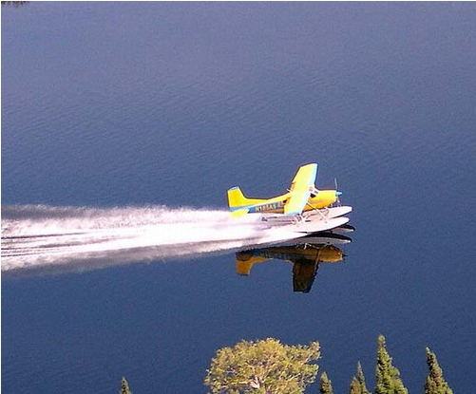
Glassy Water Take Off
Smoothness of the water increases drag on the floats.
Once airborne, visual illusions occur since we can’t tell how high we are above the water.
Roughen the water slightly by taxiing if possible.
Normal takeoff procedure except
  Apply aileron pressure so one float comes out of the water first.
  Allow airplane to turn slightly rather than holding rudder pressure (keep drag as low as possible).

Slide 21
Rough Water Take Off
The goal is to get the plane off the water as soon as possible.
Use short field take off procedure.
Apply full throttle just as bow of float rises on wave to limit amount of water on the prop.
Once on step, adjust pitch to skim across waves to lessen the pounding on the floats.
Make sure the floats are supported by two waves at all times otherwise unsafe pitching of the aircraft occurs.

Slide 22
Cross Wind Landings

Slide 23
Glassy Water Landing
150ft/mn descent rate.
Adjust pitch for 10kts above stall.
Do not Flare; Fly the airplane ontu the water.

Slide 24
Glassy Water Landing
Long shallow descent uses considerable landing distance.
Verify there is sufficient length for glide, touchdown and water run.

Slide 25
Rough Water Landing.
Land flatter than normal so that the floats slice through the waves.
Landing with a high attitude causes plane to fly back into the air at low airspeed after hitting a large wave.
Pull power and full stick back as appropriate.
If plane bounces off the wave and flies again, add power for go around.

Slide 26
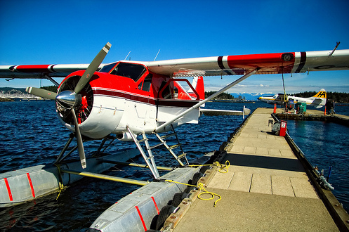
Docking
Wind should be from the nose as much as possible to slow airplane down to slowest speed possible.
Take seatbelts off, put away headsets, open door, etc. (3H’s Headset, Harness, Hatch)
Use carb heat and one magneto to slow airplane.
When dock is made, shut off engine and continue to steer with water rudders.
Step out ontu the float, pick up the mooring line connected to the rear of the float. Step ontu the dock.
Secure the mooring line to a cleat on the dock. Secure the front mooring line to the dock also.

Slide 27
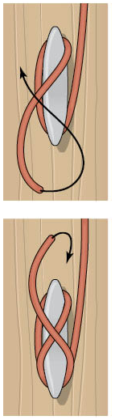
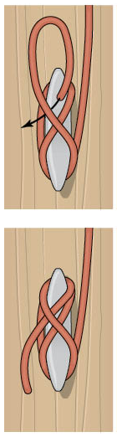
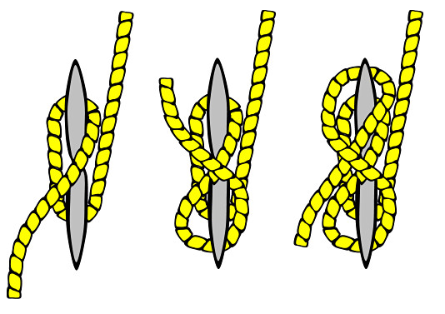
Cleat Hitch Knot
1
3
2
4

Slide 28
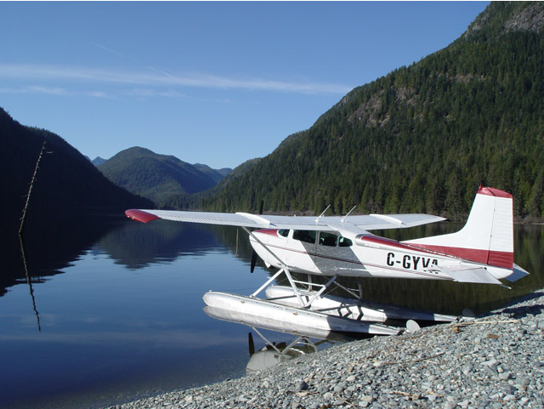
Beaching
Approach Beach with nose.
Turn off engine when beach can be made.
Lift water rudders prior to them contacting bottom.
Step into water and turn airplane around.
Tie tail down. If overnight, tie tail and both wings down firmly in case winds come up.

Slide 29
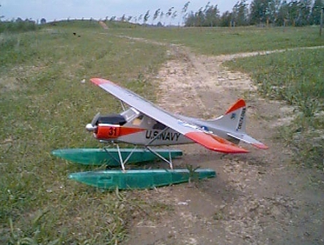
Emergency Landing
Same as for a land plane.
Land slightly flatter than normal.
If engine power available, keep a small amount of power for flatter landing.
Just prior to stopping, the tail will rise, but the long floats will prevent the airplane from tipping forward.

Slide 30
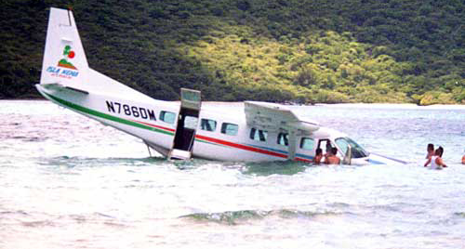
Submerged Seaplane
Doors and exits are in the same position relative to the seats no matter the orientation.
Water most likely will be murky with little light.
Bubbles rise always.
Doors and windows may not open until water is inside the plane, equalizing the pressure on both sides of the exit.
May have to allow the water to rise inside the airplane before being able to open exits.
PFD’s should be of the manual inflatable type. Do not inflate until clear of the airplane.

Slide 31
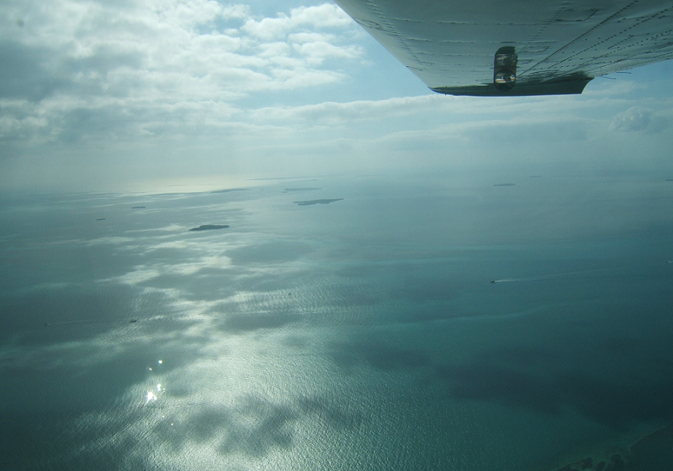
5 Points in Emergency Egress
Remain calm and wait for the aircraft to stop moving.
Identify the exit. Open the door
  Feel for the door and find the handle.
  Be aware the door may not swing freely due to damage or water pressure.
  It may be necessary to brace yourself against the aircraft as you push the door open.
Find and hold on to a fixed reference point in the airplane.
Release safety harness only when and while holding on to your fixed reference point.
  The reference point will orient you to your location in the airplane.
Pull your body out of the airplane.
  Once clear of the airplane, place one hand above your head until you surface.

Slide 32
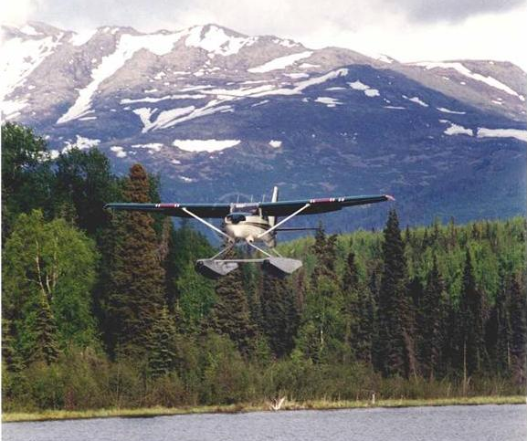
Memory Mnemonics
CARS (used before every maneuver)
  Carb heat.
  Area Clear.
  Water rudders up (or down if docking).
  Stick Back for takeoff/taxi
3H’s (used before every docking)
  Hatch (door) open.
  Headset removed and stored especially the wires.
  Harness off and stored.
NTOWL (Night Owl)
  Noise
  Terrain/Towers
  Obstacles in the water.
  Wind/Water for type of landing (Glassy, Rough, etc)
  Landing lane selection.
And the three MMM’s
  Avionics Master Off
  Mixuture Lean
  Master Off
  Mags Off

Slide 33
Practical Test Add-On Requirements
Task | Private Pilot | Comm Pilot
Systems | Explain 3 systems | Explain 5 Systems
Normal & Crosswind Takeoff | Vy +10/-5kt | Vy +/-5kts
Normal & Crosswind Landing | 1.3Vso +/-5kt. Touchdown within 400ft of specified pt | 1.3Vso +/-5kt. Touchdown within 200ft of specified pt
Short Field Takeoff/Max Performance Climb | Vx and Vy +10/-5kt | Vx and Vy +/-5kt
Short Field Approach/Landing | 1.3Vso +10/-5kt. Touchdown within 200ft of specified pt | 1.3Vso +/-5kt. Touchdown within 100ft of specified point.
Glassy Water Takeoff | Vy +10/-5kt | Vy +/-5kt
Glassy Water Approach/Landing | Stabilized approach +10/-5kt. Maintain pitch attitude and descent rate. | Stabilized approach +/-5kt. Maintain pitch attitude and descent rate.
Rough Water Approach/Landing | 1.3Vso +10/-5kt | 1.3Vso +/-5kt
Systems/Equip Malfunctions | Know and take appropriate action on 3 systems | Know and take appropriate action on 5 systems

Slide 34
Other Add-On Rating Requirements
Areas of Operation
Preflight Prep F. Performance and Limitations G. Operation of Systems. H. Water and Seaplane Characteristics. I. Seaplane Bases, Rules, Aids to Marine Navigation.
Preflight Procedures E. Taxiing and Sailing.
Airport and Seaplane Base Ops C. Airport/Seaplane Base. Runway and Taxiway Signs, Markings.
Emergency Ops A. Emergency Approach and Landing (simulated) B. Systems and equipment malfunctions.
Postflight Procedures B. Anchoring C. Docking/Mooring. D. Ramping/Beaching

Slide 35
Seaplane Transition
Ground Training
www.airtreknorth.com

